Slide 1

Implementing Computation Across the Curriculum
Todd Zimmerman
University of Wisconsin – Stout
Beyond the First Year Conference III - 2018

Slide 2
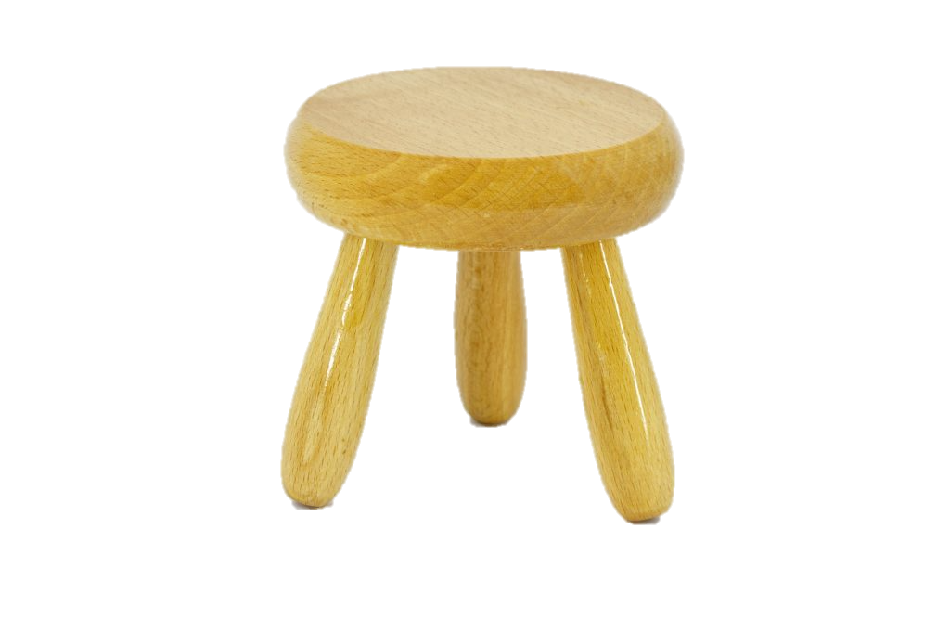
Three-Legged Stool
Physics
Theory
Experiment
Computation
[Three-legged stool]. (n.d.). Retrieved July 23, 2018, from https://marketvolt.com/2017/05/marketing-is-a-three-legged-stool/
Notes:
One of the ideas I picked up was physics as represented by a three-legged stool.
2017 Nobel prize in physics was for observation of gravitational waves, which would not have been possible without computational data analysis
The 2015 prize in physics was for the discovery of neutrino oscillations, which again required significant data analysis and modeling.
Nobel prize in chemistry in 2013 was for computational modeling of molecules

Slide 3
What does “integration of computation across the curriculum” mean?
Inclusion of computational projects and exercises across the all courses in the curriculum in an intentional and coherent fashion
Using simulations
Writing code
Use computational physics thinking in all courses
Notes:
Using computers to conduct tasks that you couldn’t otherwise accomplish
Does not necessarily mean programming but rather making use of programs, however programming can make up an important part of the curriculum.
Includes everything from using simulations, having students modify working code, giving students templates to work from, all the way up to writing code from scratch

Slide 4
Computation Implementation Space

Slide 5
Computational Physics Thinking
Formulate problem to model
Choose scale and units
Subdivide a model into a set of manageable computational tasks
Choose algorithms and computational tools
Debug, test, and validate code
Extract physical insight.
Create model
Write code
Test code
Extract insight
Notes:
Computational thinking is abstraction, automation, and analysis
Rework

Slide 6

Partnership for the Integration of Computation into Undergraduate Physics - Goals
Create community of educators
Faculty development workshops
AAPT Workshops
PICUP “Road Show”
Invite us to your department
Collect resources, strategies, and tactics to integrate computation across the curriculum
gopicup.org
Notes:
Founded by Norman Chonacky and David Winch
Show website briefly?

Slide 7
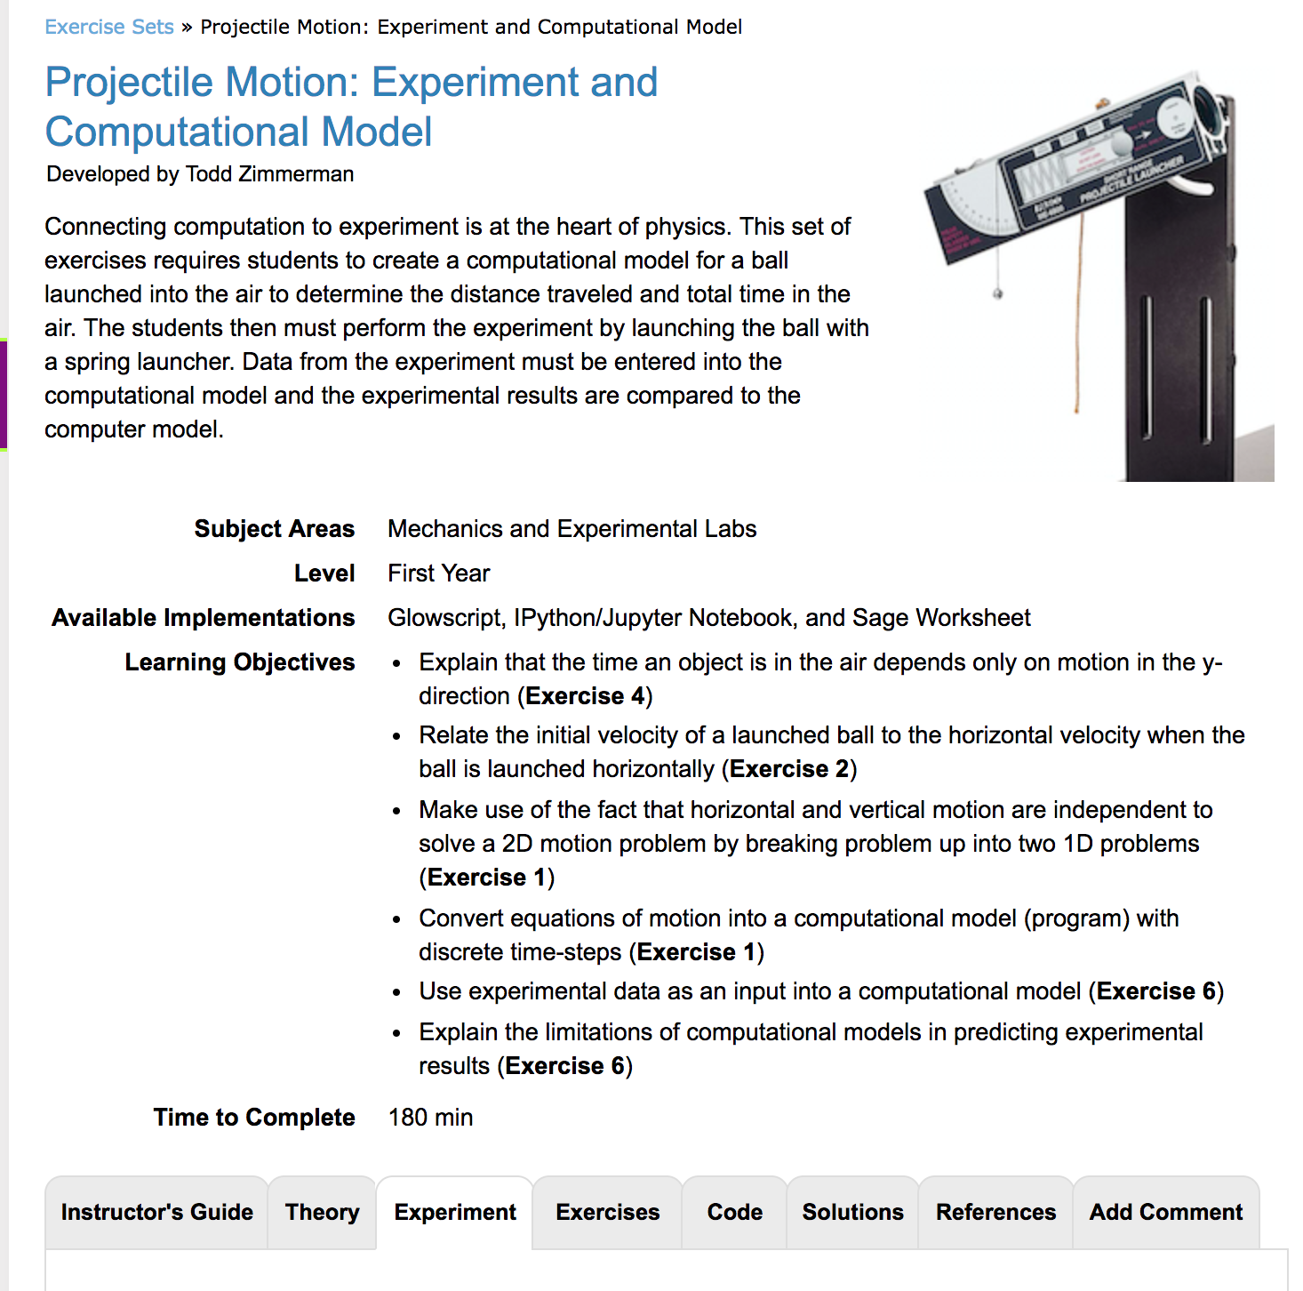
Experiment Tab
Exercise sets on gopicup.org
Notes:
We’ve added a new experiment tab to the PICUP exercise sets. This feature isn’t live yet but we envision it to be a tab where you can upload material including pdfs or other documents or link to experimental descriptions elsewhere to describe experiments that accompany computational activities.

Slide 8
We’ve made progress but…
50% of departments report at least half of faculty members assigning computational homework and a similar percentage assigning computational projects¹
63% of departments have at least one faculty member requiring computational homework
In 2006 39% of departments reported 20% of faculty included computation in their grading²
Less than 25% have half of faculty assessing computation on exams (35% report at least one faculty member doing this)
Caballero, Marcos D. "On the Prevalence and Nature of Computational Instruction in Undergraduate Physics Programs across the United States." arXiv preprint arXiv:1712.07701(2017).
Fuller, Robert G. "Numerical computations in US undergraduate physics courses." Computing in science & engineering 8.5 (2006): 16-21..
Notes:
In 2006 Robert Fuller, Norman Chonacky, and David Winch collected data from over 250 departments about computational usage.
It painted a somewhat bleak portrait of computational inclusion in physics curriculum but a more recent survey by Danny Caballero in 2017 showed we have made progress.

Slide 9
Why should computation be included in the curriculum?
Develop deeper understanding of physics
Exploration of complex systems
Develop understanding and intuition of systems beyond the few systems we can solve analytically
Give students marketable skills
Notes:
The most compelling reason is the develop a better understanding of the material.
E.g. In classical mechanics we can solve constant force, linear force (SHO), and two-body central forces. Must use computation for anything else
Can now include non-linear systems such a the double-pendulum and beyond and we can study more-than-two-body central force problems

Slide 10
Computation in the Workplace
A little less than half of bachelors graduates seek industry positions
Bachelors students in industry report 75%-90% are programming and 50%-60% are performing modeling and simulation
Based on 2017 AIP "Physics Bachelors: Initial Employment” report which is based on survey data from 2013-2014
Question: Who should we be serving and how do we best serve them?
Notes:
41% seek industry jobs while 54% go to grad school
Students in grad school obviously need to know programming too
Do we focus on the highest bar (grad-school-bound students) or on the broadest audience (grad school plus industry)

Slide 11
What hurdles do we see to implementing computation across the curriculum?
PER systemic implementation hurdles¹
Expectation of content coverage
Departmental norms
Lack of instructor time
Student resistance
Time structure
Computation systemic implementation hurdles²
Lack of instructor knowledge
Accessible platform
The IT crowd
1. Dancy, Melissa H., and Charles Henderson. "Beyond the individual instructor: Systemic constraints in the implementation of research‐informed practices." AIP Conference Proceedings. Vol. 790. No. 1. AIP, 2005.
2. Leary, Ashleigh, Paul W. Irving, and Marcos D. Caballero. "The difficulties associated with integrating computation into undergraduate physics." arXiv preprint arXiv:1807.03581(2018).
Notes:
I just want to focus on a couple of these issues.

Slide 12
Expectation of Content Coverage
Required content coverage for
Accreditation
Downstream courses
Course description
More related to time constraints
Notes:
I know some of my colleagues would disagree with me on this but I feel that as we transition from the sage on the stage model of us spewing information at students and expect them to solve large quantities of problems to an approach that requires more engagement that we have to remove content as we place higher expectations on our students.
Coverage does not equate with comprehension
Not only does computation allow students develop a deeper understanding but it also grants them a toolbox that allows them to explore more deeply on their own

Slide 13
Department Norms
Ownership of courses
Computation seen as replacing theory
Unwritten rules
Notes:
Change happens one retirement at a time

Slide 14
Lack of instructor knowledge
No programming skills
Don’t know how to design effective activities
Notes:
In the past 12 months google users in America have searched for Python more than Kim Kardashian

Slide 15
Overcoming hurdles
Recognize the hurdles
Achieve buy-in
From other faculty
From administrators
From students
Develop common learning goals
Develop curricular material
Notes:
The first step is admitting we have a problem.
J-TUPP (Joint Task for for Undergraduate Physics Programs) and AAPT Recommendations on Computation are strong tools for arguing for more computation.
Change happens one retirement at a time
Volunteer to mentor new faculty – this gives you an open line of communication about expectations and they are more likely to adopt elements of your philosophy

Slide 16
A parting thought…
Pen & Paper Methods
Computational Methods
Where does the ideal balance of computation and pen & paper work lie in developing student understanding?
Notes:
By pen & paper I mean analytical methods for solving problems that can be done on paper while computation refers more to numerical methods
A colleague warned me about bringing this up fearing I would be branded some sort of computational purist. I am not advocating a particular view, just posing the question

Slide 17
Where have all the slide rules gone?
Slide rules grant a deeper understanding of relationships between numbers
Why don’t we use them anymore?
By s58y (Keuffel & Esser slide rule, model 4081-3) [CC BY 2.0 (https://creativecommons.org/licenses/by/2.0)], via Wikimedia Commons
Notes:
Was the loss of intuition and insight gained from the slide rule worth the benefits of electric calculators?

Slide 18
Where is the “best” place to be?
Pen & Paper Methods
Computational Methods
Where does the ideal balance of computation and pen & paper work lie in developing student understanding?
Notes:
I think the balance lies closer to the computation side but this is gut instinct and we all know what eventually comes out of our gut. I'm sure you have your own opinion on this matter. My challenge to you is “prove it”. Where does the ideal balance lie? Don't be a slide rule, you really don't want to be a slide rule.
How far towards one extreme or the other do we need to be to best serve our students?
One argument frequently given against relying more on computation is that the algorithms and code tend to be black boxes, but I’d argue that at the introductory level both computation AND hand-calculations are equally black boxes.

Slide 19
Possible ALPhA/PICUP Immersion in 2019
Contact Lowell McCann or Kelly Roos for more information.

Slide 20
My challenge to you…
Answer the following:
How can you best serve your students’ need for computational skills?
Are you serving your students?
What is the best balance of pen & paper methods and computational methods to develop understanding and insight?

Slide 21
Thank you. Any questions?
Thanks to the following for funding:
Dept. of Chemistry and Physics, UW-Stout
College of Science, Technology, Engineering, Mathematics, and Management Dean
Slides and links to references at:

